Slide 1
PWM DRAWER
BY NORHAN

Slide 2
Agenda
01. Project description
02. Components and driver used
03. Simulation
04. flowchart

Slide 3
PROJECT DESCRIBTION
PWM drawer works as a mini oscilloscope that is responsible for printing the frequency and the waveform of the generated PWM signal
The generated wave came from two sources, external sources (e.g. generated PWM from other MCs), or internal source of the Microcontroller of the project itself
Where interrupt happens with every logical change .
Where with the first logical change we initiate timer while on the second time ONTIME can be calculated
Then with third logical change we can calculate the total time
So we can calculate duty cycle and frequency
Then they are showed on lcd

Slide 4
COMPONENTS :
1- microcontroller
2-lcd

Slide 5
Simulation

Slide 6
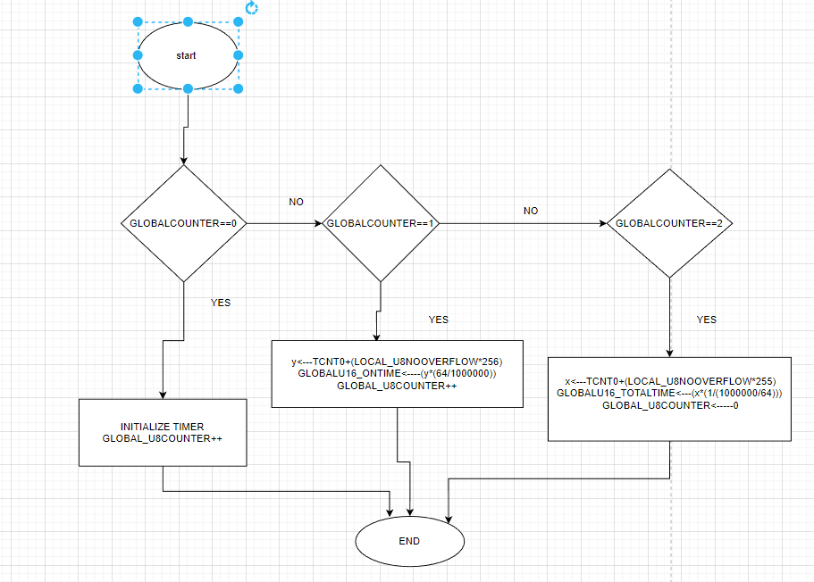
FLOWCHART:

Slide 7
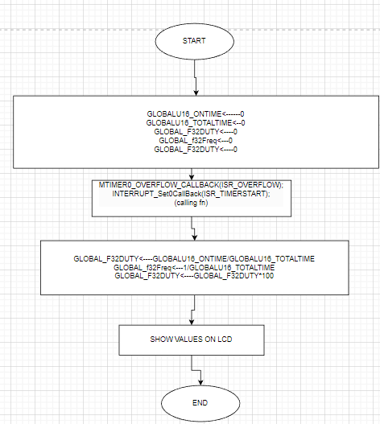
FLOWCHART:

